Slide 1
Neural Network Based
Beer Recommendation System
CS 247
Prof. Yizhou Sun
Wei Zhou
Kevan Loo
Tong Wu
Yuntian Wang

Slide 2
Motivation and Problem Statement
Pandemic time:
People are drinking alcohol more (60% overall, 500% online sales)
Taprooms and bars are closed
People are getting sick of the same beers they buy ---- need for an algorithm to give you beer recommendations based on your current preferences.

Slide 3
Data
BeerAdvocate.com is one of the most accredited and popular craft beer rating/ranking sites
Dataset includes reviews from users on how the beers: taste, look, feel, smell, and overall score
It also provides the brewery name, beer name, and review time
The data contains 1.5 Million reviews of beers from BeerAdvocate.com
Source: https://www.kaggle.com/rdoume/beerreviews
Source: https://cseweb.ucsd.edu/~jmcauley/datasets.html#multi_aspect

Slide 4
Data (example)
After removing the NaN rows
 | brewery_id | brewery_name | review_time | review_overall | review_aroma | review_appearance | review_profilename | beer_style | review_palate | review_taste | beer_name | beer_abv | beer_beerid
0 | 10325 | Vecchio Birraio | 1234817823 | 1.5 | 2.0 | 2.5 | stcules | Hefeweizen | 1.5 | 1.5 | Sausa Weizen | 5.0 | 47986
1 | 10325 | Vecchio Birraio | 1235915097 | 3.0 | 2.5 | 3.0 | stcules | English Strong Ale | 3.0 | 3.0 | Red Moon | 6.2 | 48213
2 | 10325 | Vecchio Birraio | 1235916604 | 3.0 | 2.5 | 3.0 | stcules | Foreign / Export Stout | 3.0 | 3.0 | Black Horse Black Beer | 6.5 | 48215

Slide 5
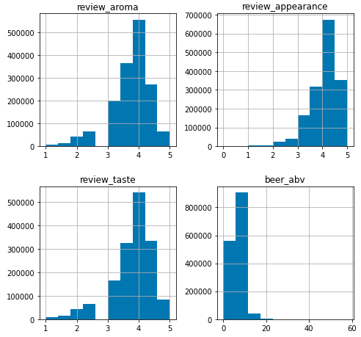
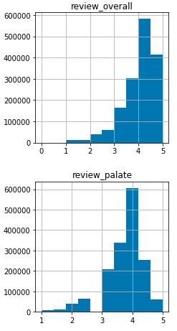
Data Exploration

Slide 6
Data Exploration
Top Reviewed Breweries
Boston Beer Company (Samuel Adams)
Dogfish Head Brewery
Stone Brewing Co.
Sierra Nevada Brewing Co.
Bell's Brewery, Inc.
Rogue Ales
Top Reviewed Beers
90 Minute IPA
India Pale Ale
Old Rasputin Russian Imperial Stout
Sierra Nevada Celebration Ale
Two Hearted Ale
Stone Ruination IPA
Top Reviewed Beer Styles
American IPA
American Double / Imperial IPA
American Pale Ale (APA)
Russian Imperial Stout
American Double / Imperial Stout
American Porter
Top 10 Popular (Reviewed + Highest Rating) Beers
90 Minute IPA
Old Rasputin Russian Imperial Stout
Sierra Nevada Celebration Ale
Two Hearted Ale
Stone Ruination IPA
Arrogant Bastard Ale
Sierra Nevada Pale Ale
Stone IPA (India Pale Ale)
Pliny The Elder
Founders Breakfast Stout

Slide 7
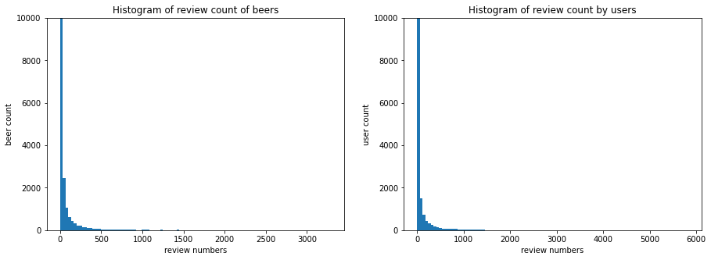
Data Exploration
Most users gives 0 reviews; and most beers receive 0 reviews.
There are 33387 unique users and 66051 unique beers in the dataset.
There are 99.93% missing entries in the sparse user-item matrix.

Slide 8
Data Processing
Removed NaN values
Removed all users who give less than 5 ratings
Did a 60%-20%-20% train, validation, test split
Ensure that the training set contains all the users and beers in the dataset to avoid new user or new item in the validation and test set

Slide 9
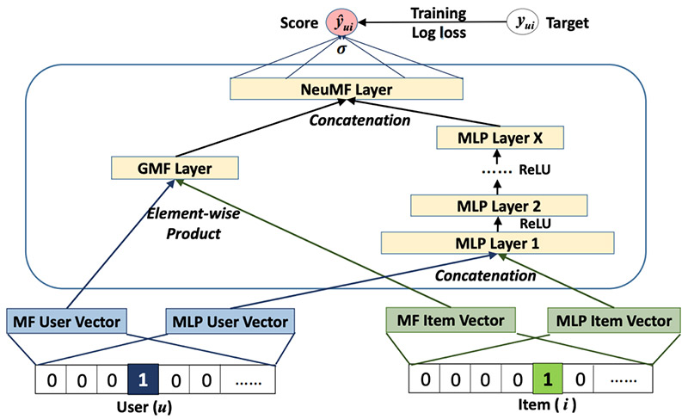
Approach
Exploratory data analysis
Data Pre-Preparation
Baseline Model:
Random Recommender
Matrix Factorization
Combined Model
Evaluation & Comparison
Conclusion
Source: https://arxiv.org/abs/1708.05031

Slide 10
Literature Review
Typical methods for explicit feedback recommendation system
Matrix Factorization
Dense Feedforward Neural Networks
Sequence Based Recommendation (RNN)
Can we improve upon these typical methods?
Neural Collaborative Filtering, He et al. (2017)
Combine the power of Matrix Factorization and neural networks to improve recommendation performance

Slide 11
Literature Review
Neural Collaborative Filtering
Pros:
Combines use of DNN’s with Matrix Factorization to capture addition user-item interactions
Pre-training of sub-models provide good initializations for final model
Cons:
Can’t capture time related properties of user-item reviews

Slide 12
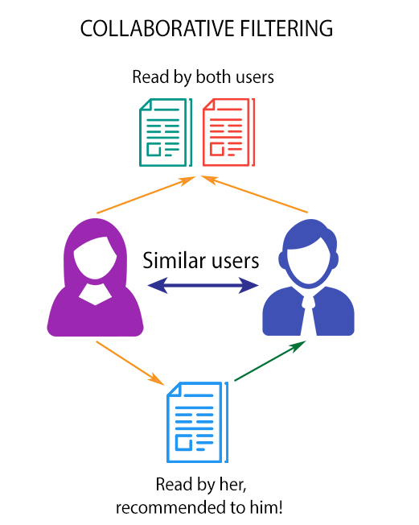
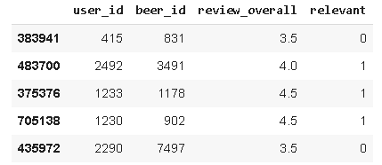
Item Recommendation as a classification problem
Predict the probability that an item is relevant to a user

Slide 13
Baseline Models
Random Recommender
Randomly assign 0-5 score to each user-item combination in the test set
Perform poorly as expected
Matrix Factorization
Decompose user-beer rating matrix into a set of user factors and a set of beer factors
Number of factors = 10
Predict score from 0-5 given a user ID and beer ID

Slide 14
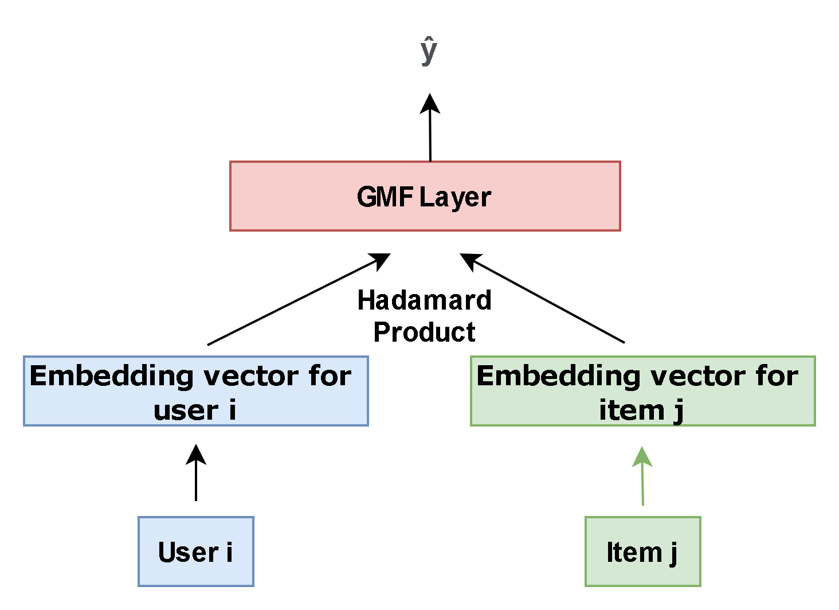
Generalized Matrix Factorization
Element wise product between user embedding and item embedding like MF
GMF layer consists of an output fully connected layer, h, and a sigmoid activation
GMF allows learning of latent dimensions with varying importance when compared to vanilla MF

Slide 15
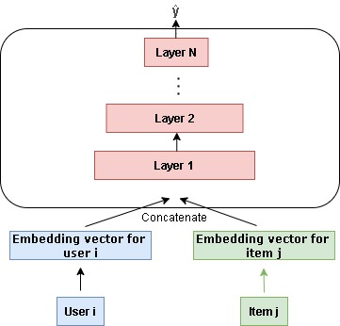
MLP Embedding Model
Concatenation of user and item embeddings in combination with hidden layers learn interactions between users and items
Each fully connected layer is followed by a Batch Normalization layer, a dropout layer
ReLU is used as the activation function

Slide 16
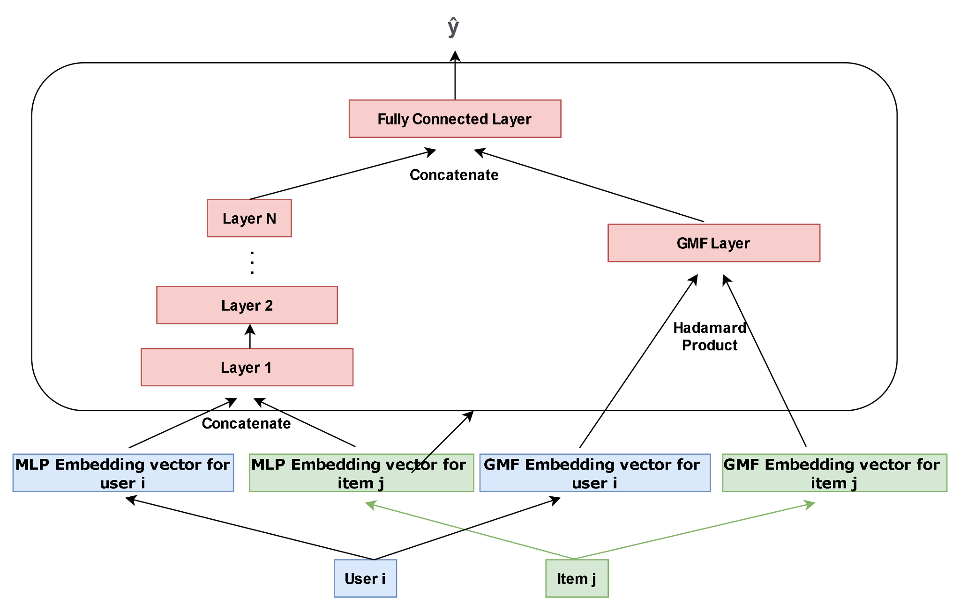
Neural Factorization (GMF + MLP)

Slide 17
Neural Factorization (GMF + MLP)
MLP and GMF models are trained separately until convergence
Weights of the pretrained models are used as initialization for the combined model
Output of MLP and GMF are scaled by an 𝞪 and (1-𝞪) hyperparameter, concatenated, then fed into a fully connected layer

Slide 18
Evaluation Metrics
Precision@5 = (# of recommended items @5 that are relevant) / (# of recommended items @5)
Recall@5 = (# of recommended items @5 that are relevant) / (total # of relevant items)

Slide 19
Results
Model | Precision@5 | Recall@5
Random Recommender | 0.3858 | 0.1570
Matrix Factorization | 0.4434 | 0.3394
Generalized Matrix Factorization | 0.6198 | 0.4561
MLP Embedding | 0.6595 | 0.4911
GMF + MLP (NeuMF) | 0.6802 | 0.5492

Slide 20
Comparison with Existing Approaches
Our Generalized Matrix Factorization and MLP Embedding model both outperformed the baseline Random Recommender and baseline Matrix Factorization models in Precision@5 and Recall@5
The Neural Factorization model combining GMF and MLP outperformed all the models we tested with a Recall@5 of 0.5492 and a Precision@5 of 0.6802

Slide 21
Conclusion
We were able to implement a creative solution to improving beer recommendation based on BeerAdvocate.com user-item ratings
The Neural MF model combining GMF and MLP models showed great improvement in recommendation performance when compared to the baseline models and each submodel by itself
The improvement of recommendation performance on the beer ratings dataset shows that combining the power of deep learning with existing collaborative filtering solutions improves the capture of user-item relationships

Slide 22
Reference
https://stackoverflow.com/questions/35393775/how-can-i-ensure-that-the-users-and-items-appear-in-both-train-and-test-data-set
https://discuss.pytorch.org/t/merging-two-models/45637
https://surprise.readthedocs.io/en/stable/FAQ.html
https://towardsdatascience.com/introduction-to-recommender-systems-2-deep-neural-network-based-recommendation-systems-4e4484e64746
http://staff.ustc.edu.cn/~hexn/papers/www17-ncf.pdf

Slide 23
Thank you - Q & A

